Slide 1


Keith Jackson
08/27/2025

Slide 2

Outline
Executive Summary
Introduction
Methodology
Results
Conclusion
Appendix

Slide 3
Executive Summary
Summary of methodologies
Data Collection
Data Wrangling
Exploratory Data Analysis with Data Visualization
Exploratory Data Analysis with SQL
Building an interactive map with Folium
Building a Dashboard with Plotly Dash
Predictive Analysis (Classification)
Summary of all results
Exploratory Data Analysis Results
Interactive Analytics Demo in Screenshots
Predictive Analysis Results

Slide 4
Introduction
Project background and context
Space X is the most successful company of the commercial space age, making space travel affordable. The company advertises Falcon 9 rocket launches on its website, with a cost of 62 million dollars; other providers cost upward of 165 million dollars each, much of the savings is because SpaceX can reuse the first stage. Therefore, if we can determine if the first stage will land, we can determine the cost of a launch. Based on public information and machine learning models, we are going to predict if SpaceX will reuse the first stage.
Problems you want to find answers
SpaceX is the most successful company of the commercial space age, making space travel affordable. The company advertises Falcon 9 rocket launches on its website, with a cost of 62 million dollars; other providers cost upward of 165 million dollars each, much of the savings is because SpaceX can reuse the first stage. Therefore, if we can determine if the first stage will land, we can determine the cost of a launch. Based on public information and machine learning models, we are going to predict if SpaceX will reuse the first stage.

Slide 5

Section 1

Slide 6
Methodology
Executive Summary
Data collection methodology:
Data was extracted from the Space X launch data, using an API (Space X REST API). The API gave us data about launches, including information about the rocket used, payload delivered, launch specifications, landing specifications, and landing outcome.
Another popular data source for obtaining Falcon 9 Launch data is web scraping related Wiki pages.
Perform data wrangling
Took the data calculated the number of launches on each site. Then, calculate the number and occurrence of each orbit. Next, Calculate the number and occurrence of mission outcome of the orbits. Lastly, created a landing outcome label from Outcome column (0 if bad outcome, 1 otherwise).
Perform exploratory data analysis (EDA) using visualization and SQL
Perform interactive visual analytics using Folium and Plotly Dash
Perform predictive analysis using classification models
How to build, tune, evaluate classification models

Slide 7
Data Collection
Describe how data sets were collected.
Data collection process involved a combination of API requests from SpaceX REST API and Web Scraping data from a table in SpaceX’s Wikipedia entry.
You need to present your data collection process use key phrases and flowcharts
Data Columns are obtained by using SpaceX REST API:
FlightNumber, Date, BoosterVersion, PayloadMass, Orbit, LaunchSite, Outcome, Flights, GridFins, Reused, Legs, LandingPad, Block, ReusedCount, Serial, Longitude, Latitude
Data Columns are obtained by using Wikipedia Web Scraping:
Flight No., Launch site, Payload, PayloadMass, Orbit, Customer, Launch outcome, Version Booster, Booster landing, Date, Time

Slide 8
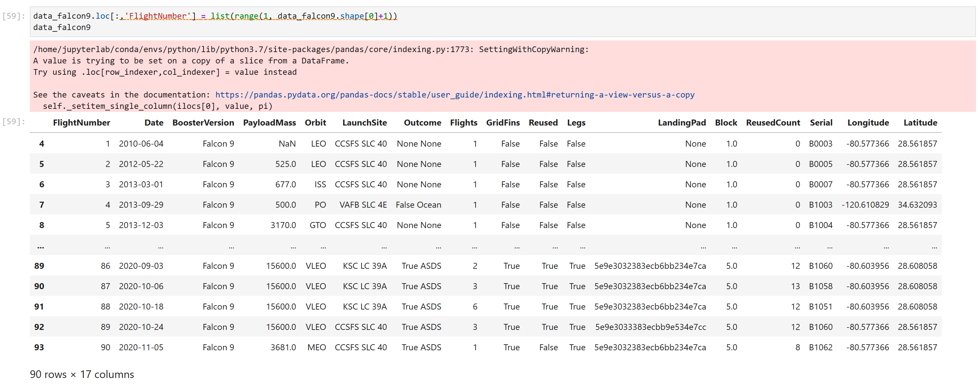
Data Collection: Filtered the dataframe of only Falcon 9 launches

Slide 9
Data Collection – SpaceX API
Present your data collection with SpaceX REST calls using key phrases and flowcharts
Add the GitHub URL of the completed SpaceX API calls notebook (must include completed code cell and outcome cell), as an external reference and peer-review purpose
Place your flowchart of SpaceX API calls here

Slide 10
Data Collection – SpaceX API
Decoding the response content using .json() and turning it into a dataframe using
.json_normalize()
Requesting needed information about the launches from SpaceX API
by applying custom functions
Requesting rocket launch data from SpaceX API
Constructing data we have obtained into a dictionary
Replacing missing values of Payload Mass column with calculated .mean() for this column
Filtering the dataframe to only include Falcon 9 launches
Exporting the data to CSV
Creating a dataframe from the dictionary

Slide 11
Data Collection - Scraping
Present your web scraping process using key phrases and flowcharts
Add the GitHub URL of the completed web scraping notebook, as an external reference and peer-review purpose
Place your flowchart of web scraping here

Slide 12
Data Collection - Scraping
Requesting Falcon 9 launch data from Wikipedia
Creating a BeautifulSoup object from the HTML response
Extracting
all column names from the HTML table header
Collecting the data by parsing HTML tables
Exporting the data to CSV
Creating a dataframe from the dictionary
Constructing data we have obtained into a dictionary
https://github.com/kobekeith8/Winning-Space-Race-with-Data-Science/blob/main/jupyter-labs-spacex-data-collection-api.ipynb

Slide 13
Data Wrangling
Describe how data were processed
You need to present your data wrangling process using key phrases and flowcharts
Add the GitHub URL of your completed data wrangling related notebooks, as an external reference and peer-review purpose

Slide 14
Data Wrangling
In the data set, there are several different cases where the booster did not land successfully. Sometimes a landing was attempted but failed due to an accident; for example, True Ocean means the mission outcome was successfully landed to a specific region of the ocean while False Ocean means the mission outcome was unsuccessfully landed to a specific region of the ocean. True RTLS means the mission outcome was successfully landed to a ground pad False RTLS means the mission outcome was unsuccessfully landed to a ground pad.True ASDS means the mission outcome was successfully landed on a drone ship False ASDS means the mission outcome was unsuccessfully landed on a drone ship.
We mainly convert those outcomes into Training Labels with “1” means the booster successfully landed, “0” means it was unsuccessful.
Perform exploratory Data Analysis and determine Training Labels
Calculate the number of launches on each site
Calculate the number and occurrence of each orbit
Calculate the number and occurrence of mission outcome per orbit type
Create a landing outcome label from Outcome column
Exporting the data to CSV
https://github.com/kobekeith8/Winning-Space-Race-with-Data-Science/blob/main/labs-jupyter-spacex-Data%20wrangling.ipynb

Slide 15
EDA with Data Visualization
Flight Number vs. Payload Mass, Flight Number vs. Launch Site, Payload Mass vs. Launch Site, Orbit Type vs. Success Rate, Flight Number vs. Orbit Type, Payload Mass vs Orbit Type and Success Rate Yearly Trend
Scatter plots show the relationship between variables. If a relationship exists, they could be used in machine learning model.
Bar charts show comparisons among discrete categories. The goal is to show the relationship between the specific categories being compared and a measured value.
Line charts show trends in data over time (time series).
https://github.com/kobekeith8/Winning-Space-Race-with-Data-Science/blob/main/edadataviz.ipynb

Slide 16
EDA with SQL
Performed SQL queries:
Displaying the names of the unique launch sites in the space mission
Displaying 5 records where launch sites begin with the string ‘CCA'
Displaying the total payload mass carried by boosters launched by NASA (CRS)
Displaying average payload mass carried by booster version F9 v1.1
Listing the date when the first successful landing outcome in ground pad was achieved
Listing the names of the boosters which have success in drone ship and have payload mass greater than 4000 but less than 6000
Listing the total number of successful and failure mission outcomes
Listing the names of the booster versions which have carried the maximum payload mass
Listing the failed landing outcomes in drone ship, their booster versions and launch site names for the months in year 2015
Ranking the count of landing outcomes (such as Failure (drone ship) or Success (ground pad)) between the date 2010-06-04 and 2017-03-20 in descending order
https://github.com/kobekeith8/Winning-Space-Race-with-Data-Science/blob/main/jupyter-labs-eda-sql-coursera_sqllite.ipynb

Slide 17
Build an Interactive Map with Folium
Markers of All Launch Sites
Added Marker with Circle, Pop-up label and text label of NASA Johnson Space Center using its latitude and longitude coordinates as a start location.
Coloured Markers of the launch outcomes for each Launch Site:
Added coloured Markers of success (Green) and failed (Red) launches using Marker Cluster to identify which launch sites have relatively high success rates.
Distances between a Launch Site to its proximities:
Added coloured Lines to show distances between the Launch Site KSC LC-39A (as an example) and its proximities like Railway, Highway, Coastline and Closest City.
https://github.com/kobekeith8/Winning-Space-Race-with-Data-Science/blob/main/lab_jupyter_launch_site_location.ipynb

Slide 18
Build a Dashboard with Plotly Dash
Added a dropdown list to enable Launch Site selection.
Pie Chart showing Success Launches (All Sites/Certain Site):
Added a pie chart to show the total successful launches count for all sites and the Success vs. Failed counts for the site, if a specific Launch Site was selected.
Slider of Payload Mass Range:
Added a slider to select Payload range.
Scatter Chart of Payload Mass vs. Success Rate for the diﬀerent Booster Versions:
Added a scatter chart to show the correlation between Payload and Launch Success.
https://github.com/kobekeith8/Winning-Space-Race-with-Data-Science/blob/main/spacex-dash-app.py

Slide 19
Predictive Analysis (Classification)
Summarize how you built, evaluated, improved, and found the best performing classification model
You need present your model development process using key phrases and flowchart
Add the GitHub URL of your completed predictive analysis lab, as an external reference and peer-review purpose

Slide 20
Predictive Analysis (Classification)
Standardizing the data with StandardScaler, then fitting and transforming it
Splitting the data into training and testing sets with train_test_split function
Creating a GridSearchCV object with cv = 10 to find the best parameters
Creating a NumPy array from the column “Class” in data
Finding the method performs best by examining the Jaccard_score and F1_score metrics
Calculating the accuracy on the test data using the method .score()
for all models
Applying GridSearchCV on LogReg, SVM,
Decision Tree, and KNN models
Examining the confusion matrix for all models
https://github.com/kobekeith8/Winning-Space-Race-with-Data-Science/blob/main/SpaceX_Machine%20Learning%20Prediction_Part_5.ipynb

Slide 21
Results
Exploratory data analysis results
Interactive analytics demo in screenshots
Predictive analysis results

Slide 22

Section 2

Slide 23
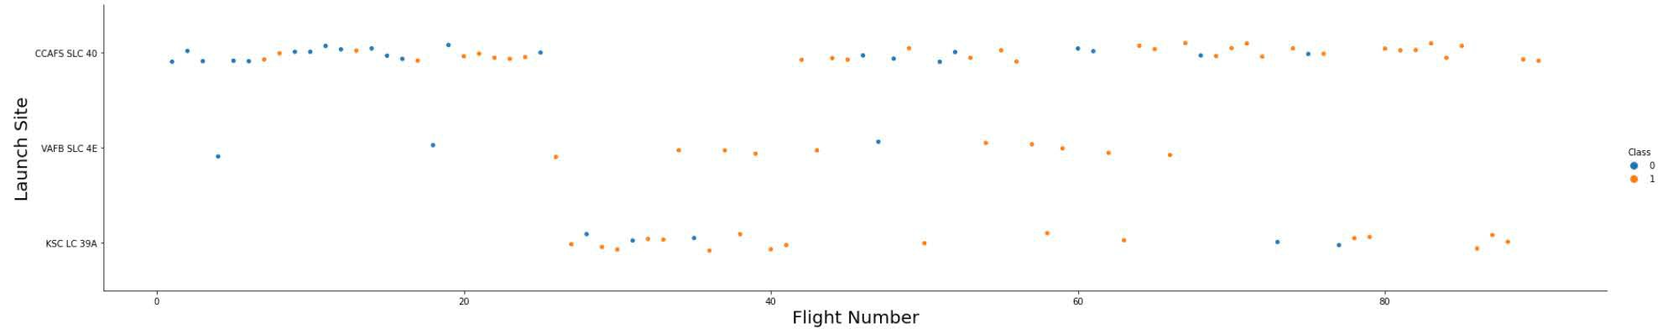
Flight Number vs. Launch Site
Explanation:
The earliest flights all failed while the latest flights all succeeded.
The CCAFS SLC 40 launch site has about a half of all launches.
VAFB SLC 4E and KSC LC 39A have higher success rates.
It can be assumed that each new launch has a higher rate of success.

Slide 24
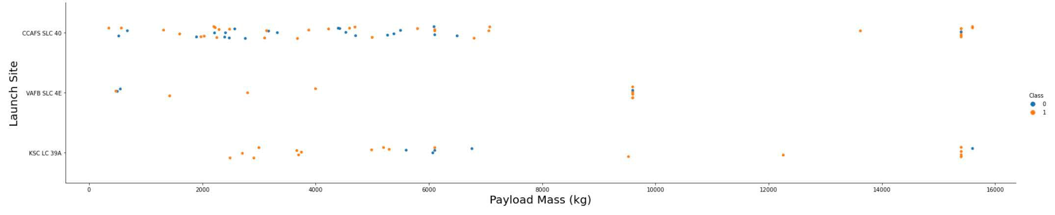
Payload vs. Launch Site
Explanation:
For every launch site the higher the payload mass, the higher the success rate.
Most of the launches with payload mass over 7000 kg were successful.
KSC LC 39A has a 100% success rate for payload mass under 5500 kg too.

Slide 25
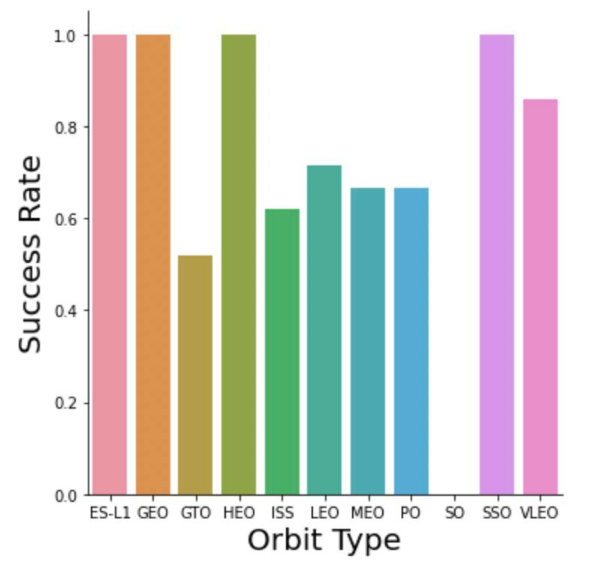
Explanation:
Success Rate vs. Orbit Type
Orbits with 100% success rate:
ES-L1, GEO, HEO, SSO
Orbits with 0% success rate:
SO
Orbits with success rate between 50% and 85%:
GTO, ISS, LEO, MEO, PO

Slide 26
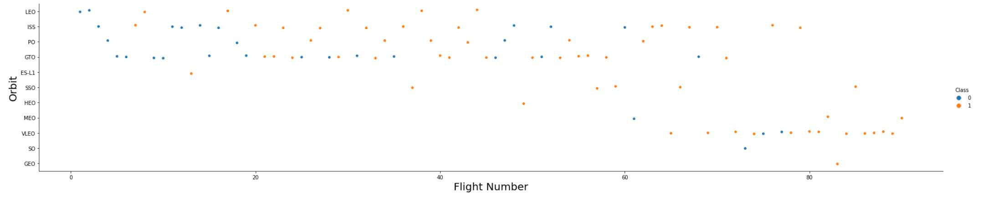
Flight Number vs. Orbit Type
Explanation:
In the LEO orbit the Success appears related to the number of flights; on the other hand, there seems to be no relationship between flight number when in GTO orbit.

Slide 27
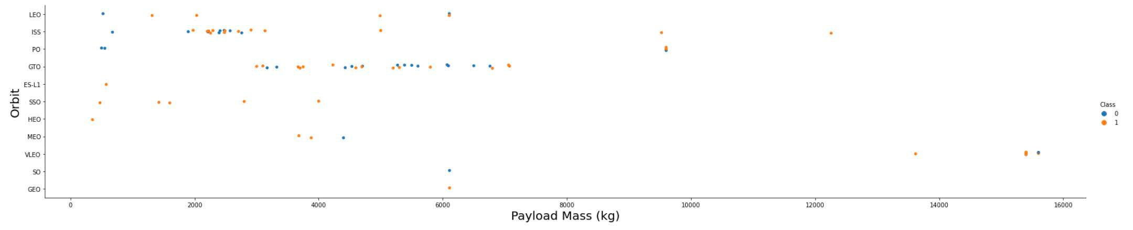
Payload vs. Orbit Type
Explanation:
Heavy payloads have a negative influence on GTO orbits and positive on GTO and Polar LEO (ISS) orbits.

Slide 28
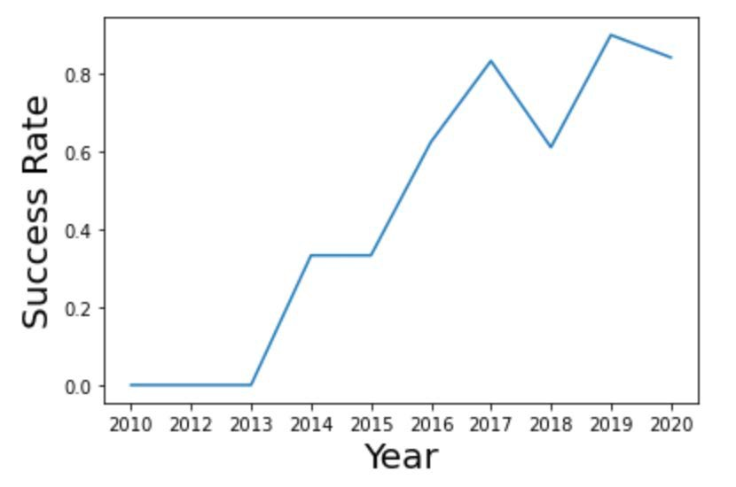
Explanation:
Launch Success Yearly Trend
The success rate since 2013 kept
increasing till 2019 where it decrease. Then jumped back up in 2020 and started to decline again

Slide 29
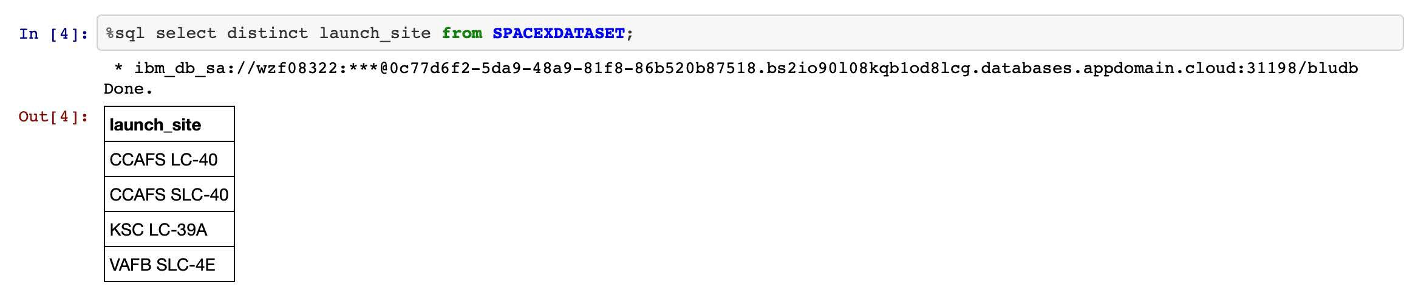
All Launch Site Names
Explanation:
Displaying the names of the unique launch sites in the space mission.

Slide 30
All Launch Site Names
Find the names of the unique launch sites
Present your query result with a short explanation here

Slide 31
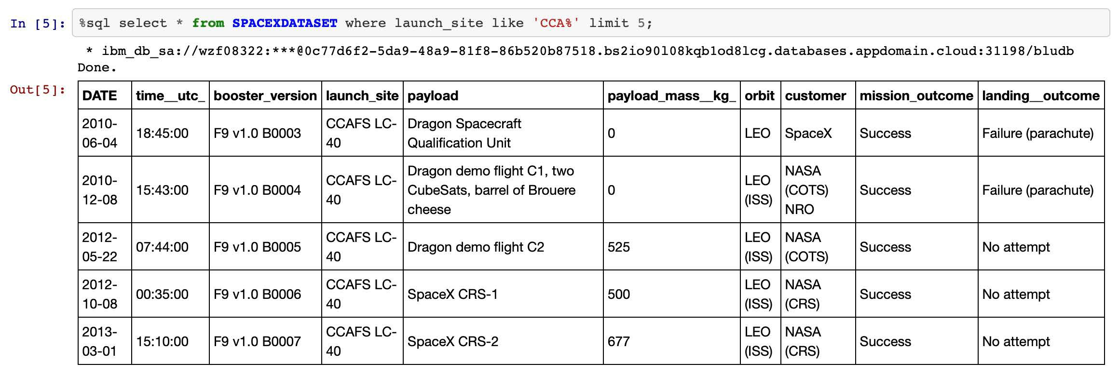
Launch Site Names Begin with 'CCA'
Explanation:
Displaying 5 records where launch sites begin with the string 'CCA'.

Slide 32
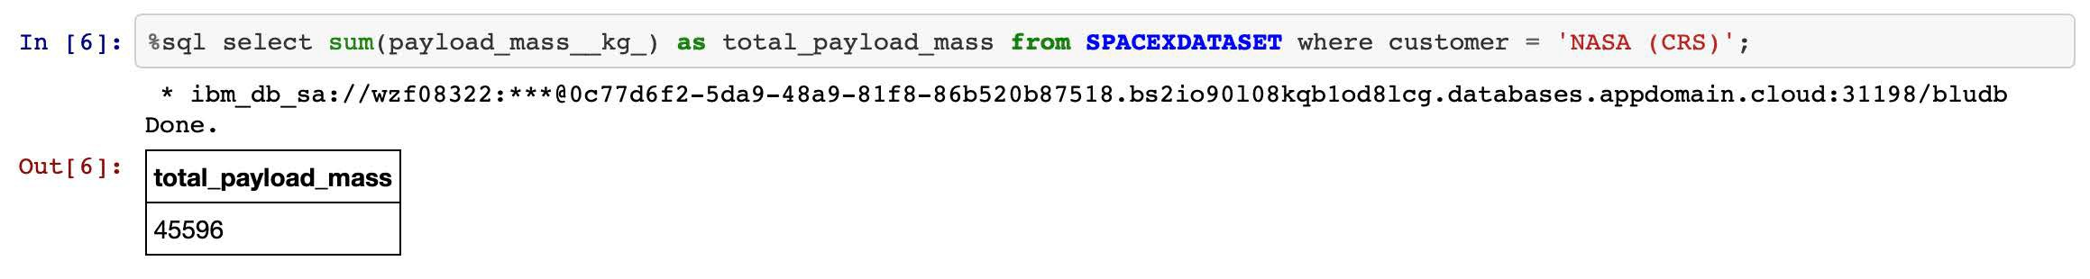
Total Payload Mass
Explanation:
Displaying the total payload mass carried by boosters launched by NASA (CRS).

Slide 33
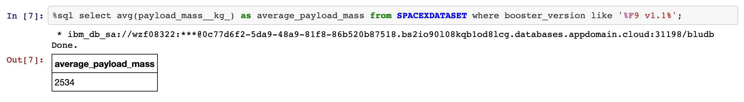
Average Payload Mass by F9 v1.1
Explanation:
Displaying average payload mass carried by booster version F9 v1.1.

Slide 34
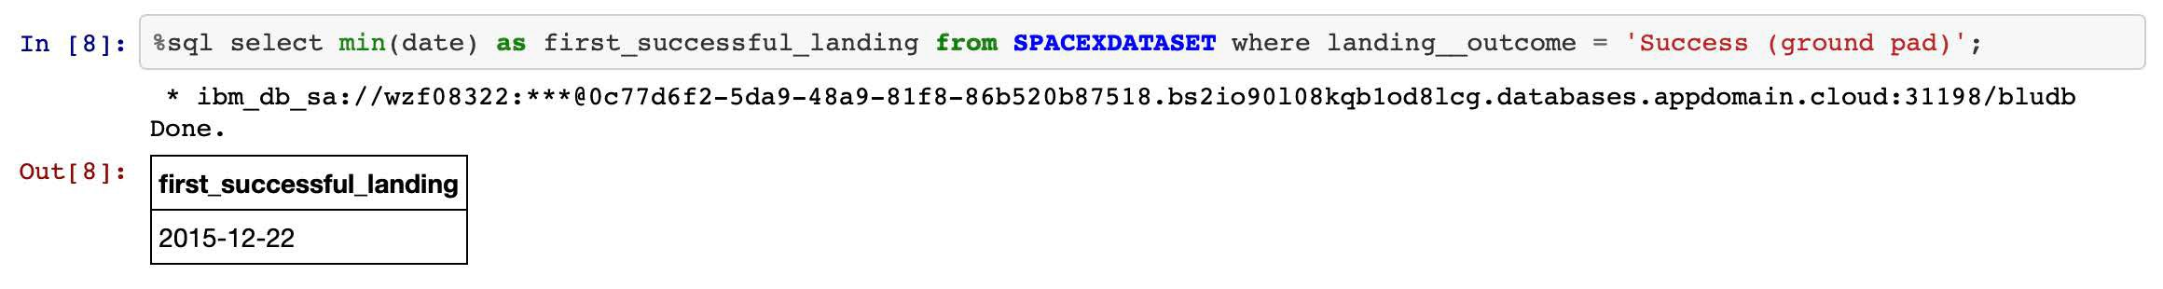
First Successful Ground Landing Date
Explanation:
Listing the date when the first successful landing outcome in ground pad was achieved.

Slide 35
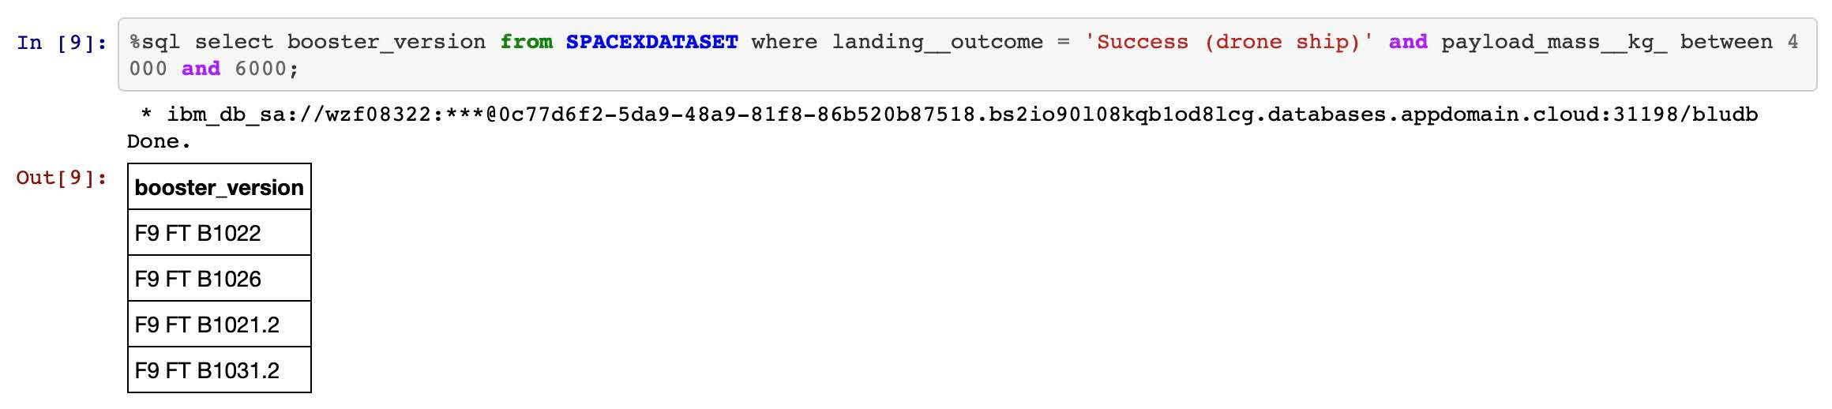
Successful Drone Ship Landing with Payload between 4000 and 6000
Explanation:
Listing the names of the boosters which have success in drone ship and have payload mass greater than 4000 but less than 6000.

Slide 36
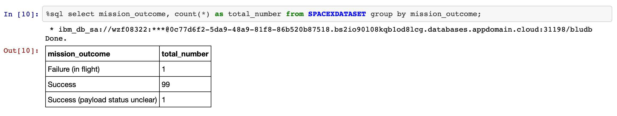
Total Number of Successful and Failure Mission Outcomes
Explanation:
Listing the total number of successful and failure mission outcomes.

Slide 37
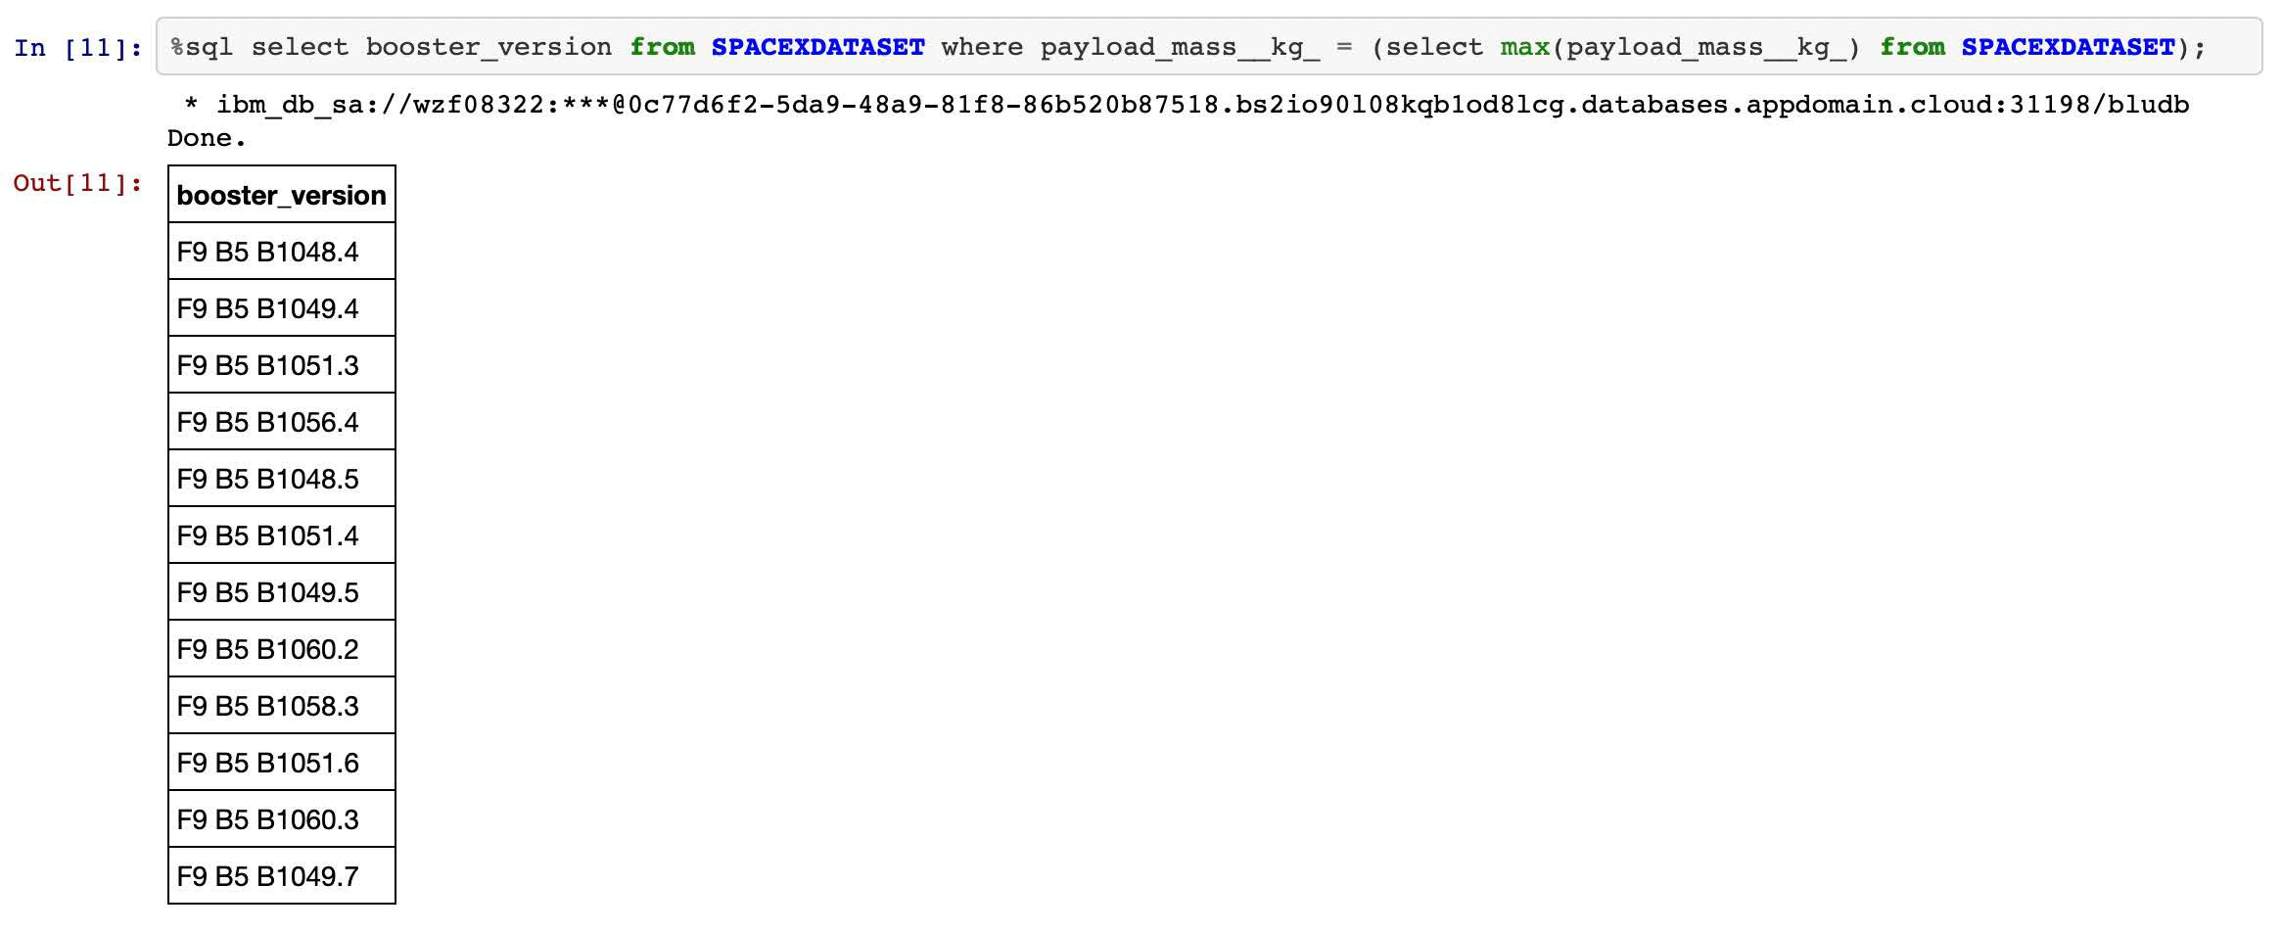
Boosters Carried Maximum Payload
Explanation:
Listing the names of the booster versions which have carried the maximum payload mass.

Slide 38
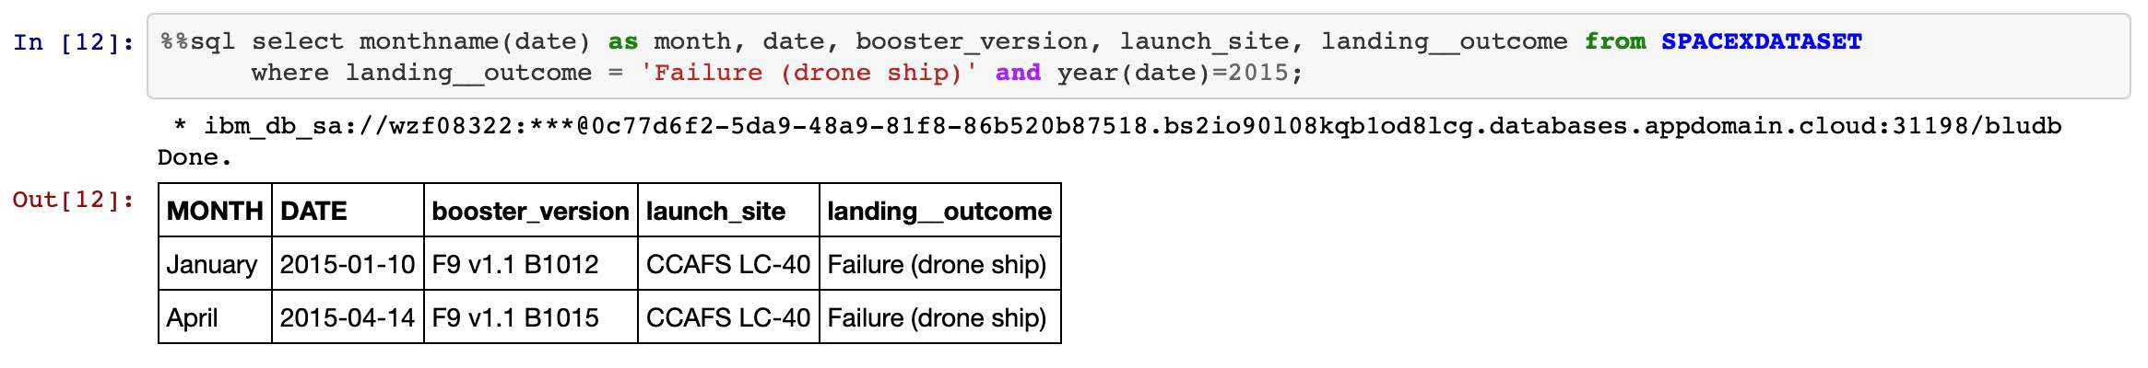
2015 Launch Records
Explanation:
Listing the failed landing outcomes in drone ship, their booster versions and launch site names for the months in year 2015.

Slide 39
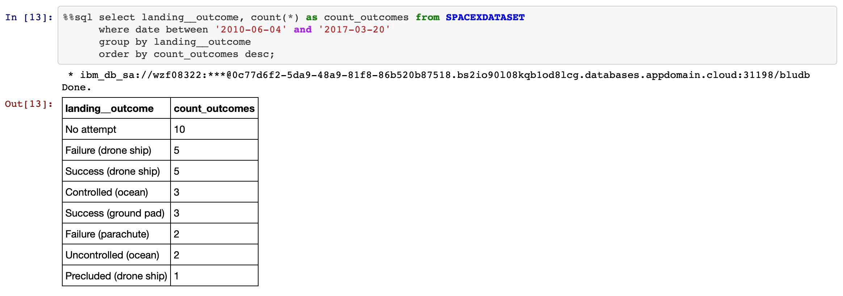
Rank Landing Outcomes Between 2010-06-04 and 2017-03-20
Explanation:
Ranking the count of landing outcomes (such as Failure (drone ship) or Success (ground pad)) between the date 2010-06-04 and 2017-03-20 in descending order.

Slide 40

Section 3

Slide 41
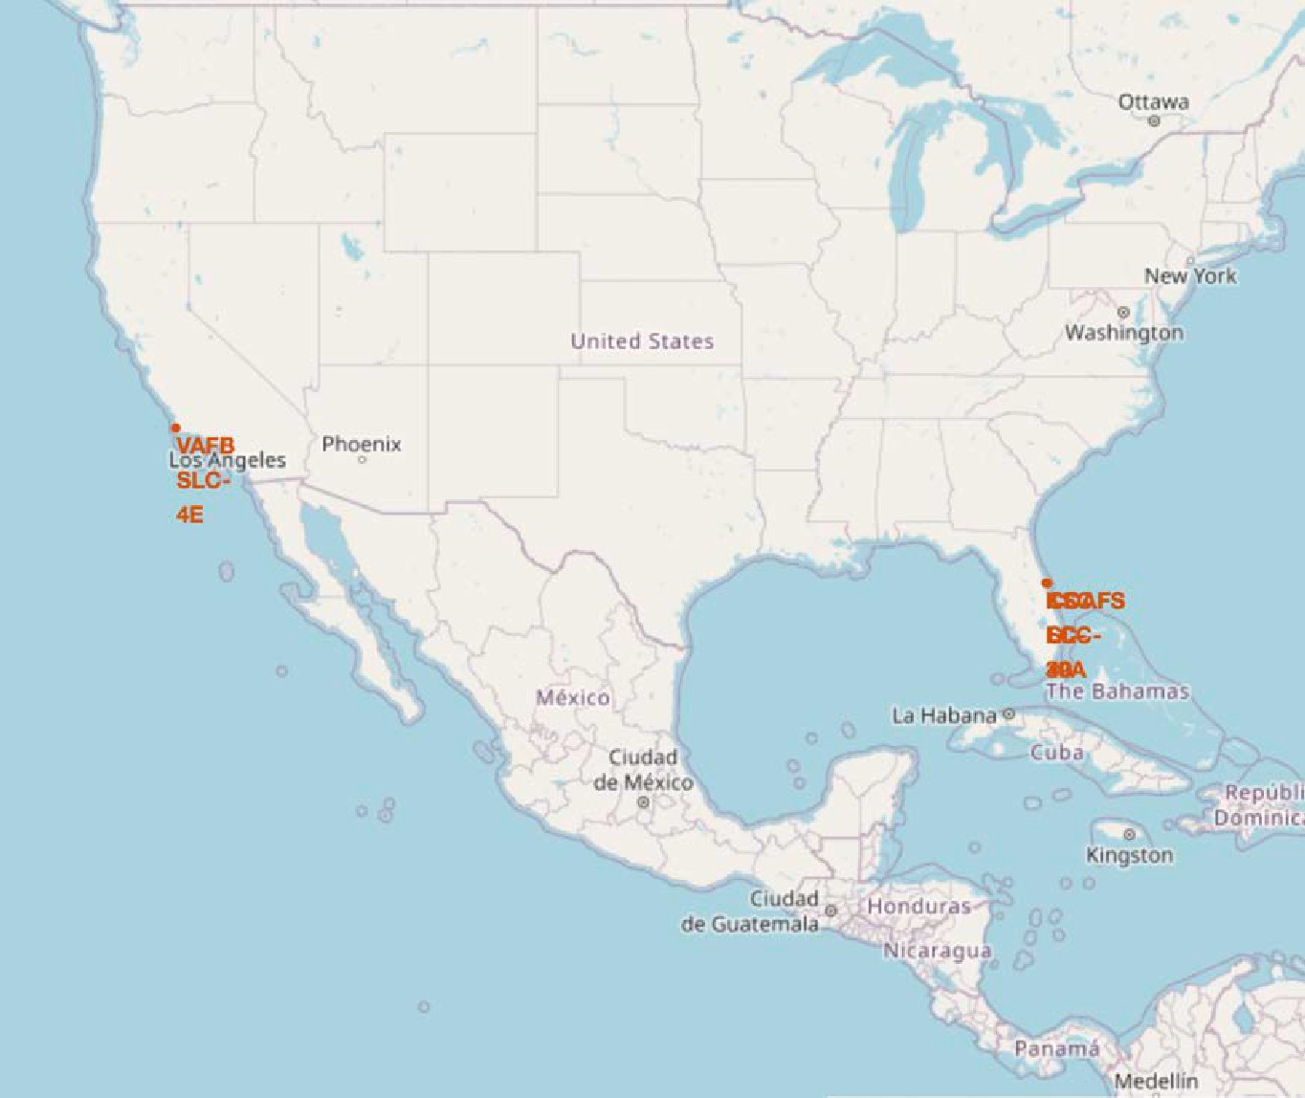
First Successful Ground Landing Date
Explanation:
Most of Launch sites are in proximity to the Equator line. The land is moving faster at the equator than any other place on the surface of the Earth. Anything on the surface of the Earth at the equator is already moving at 1670 km/hour. If a ship is launched from the equator it goes up into space, and it is also moving around the Earth at the same speed it was moving before launching. This is because of inertia. This speed will help the spacecraft keep up a good enough speed to stay in orbit.
All launch sites are in very close proximity to the coast, while launching rockets towards the ocean it minimises the risk of having any debris dropping or exploding near people.

Slide 42
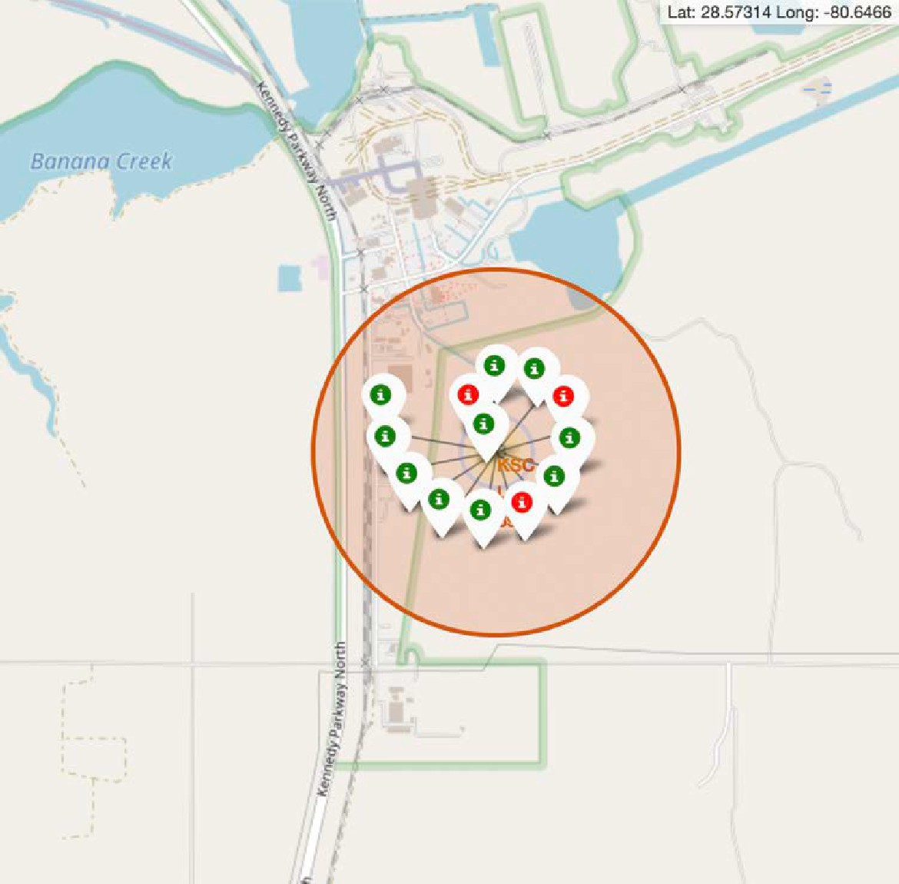
Explanation:
Success/Fail Launch Record on the Map
From the colour-labeled markers we should be able to easily identify which launch sites have relatively high success rates.
Green Marker = Successful Launch
Red Marker = Failed Launch
Launch Site KSC LC-39A has a very high Success Rate.

Slide 43
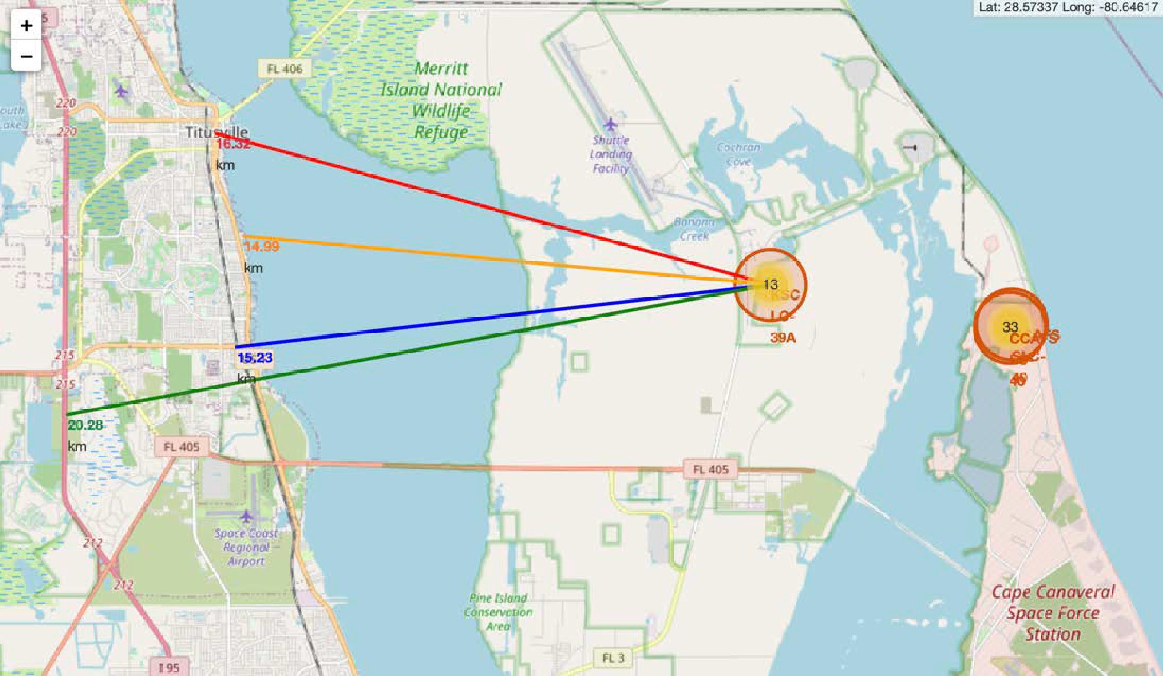
Distances From the Launch Site: KSC LC-39A to Proximities
Explanation:
From the visual analysis of the launch site KSC LC-39A we can clearly see that it is:
relative close to railway (15.23 km)
relative close to highway (20.28 km)
relative close to coastline (14.99 km)
Also the launch site KSC LC-39A is relative close to its closest city Titusville (16.32 km).
Failed rocket with its high speed can cover distances like 15-20 km in few seconds. It could be potentially dangerous to populated areas.

Slide 44

Section 4

Slide 45
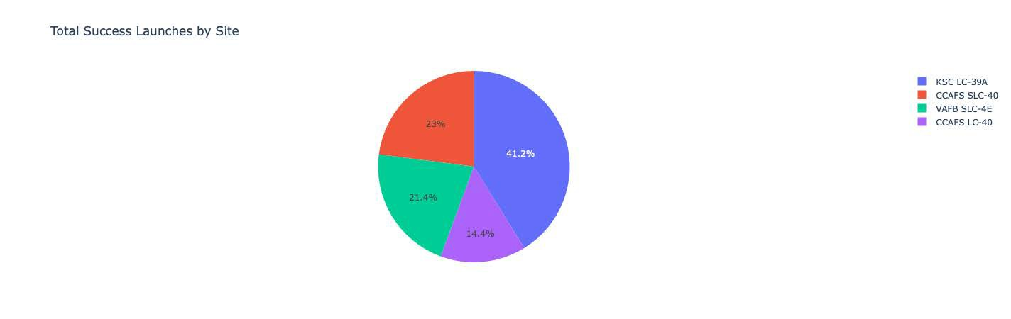
Successful Launched (All Sites)
Explanation:
The chart clearly shows that from all the sites, KSC LC-39A has the most successful launches.

Slide 46
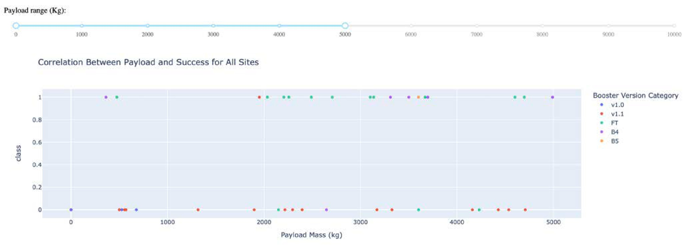
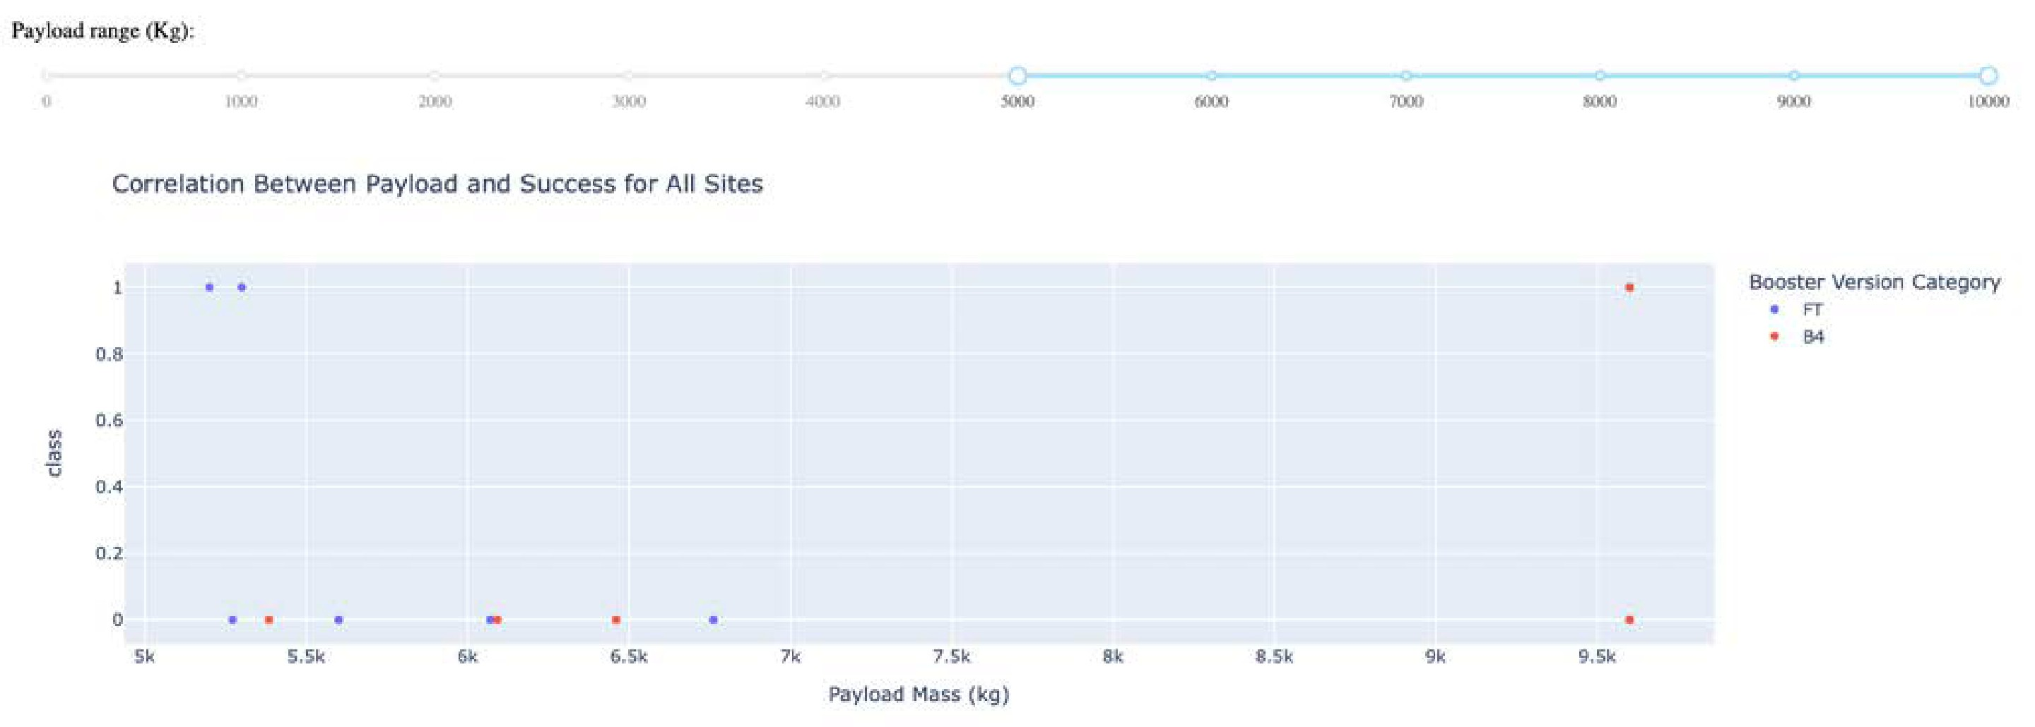
Explanation:
Payload Mass vs. Launch Outcomes for All Sites
The charts show that payloads between 2000 and 5500 kg have the highest success rate.

Slide 47

Section 5

Slide 48
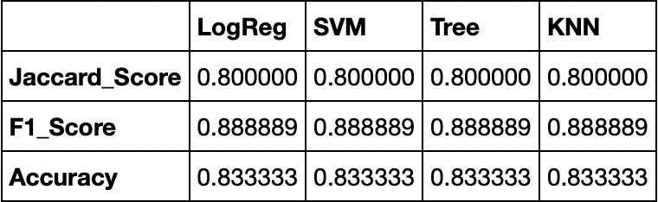
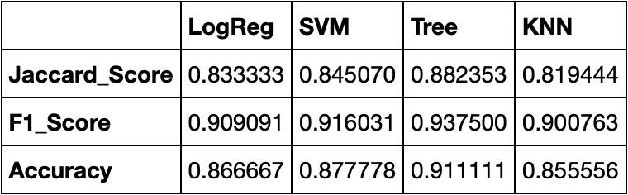
Scores and Accuracy of the Test Set
Classification Accuracy
Explanation:
Based on the scores of the Test Set, we can not confirm which method performs best.
Same Test Set scores may be due to the small test sample size (18 samples). Therefore, we tested all methods based on the whole Dataset.
The scores of the whole Dataset confirm that the best model is the Decision Tree Model. This model has not only higher scores, but also the highest accuracy.
Scores and Accuracy of the Entire Data Set

Slide 49
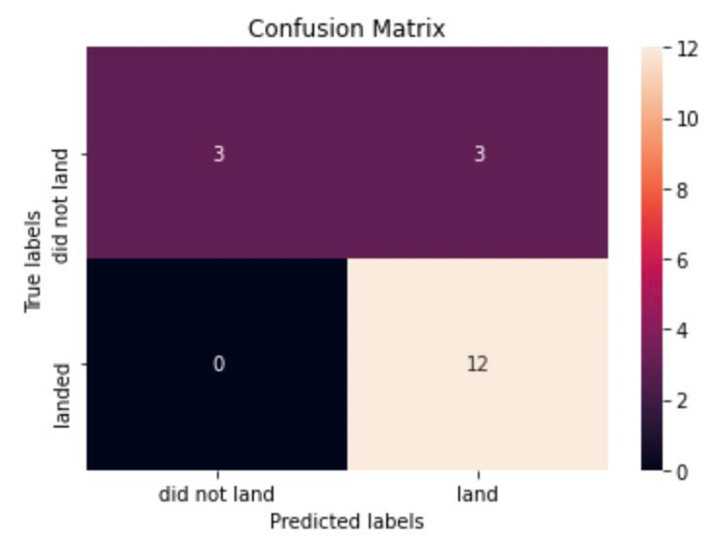
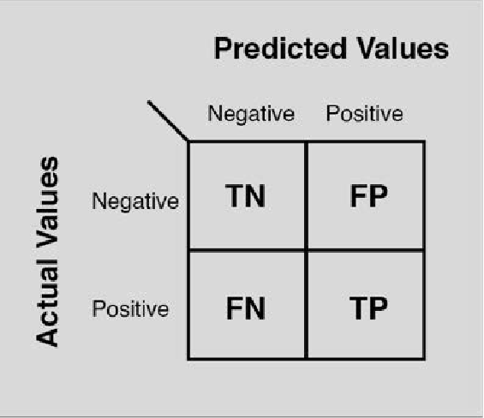
Explanation:
Confusion Matrix
Examining the confusion matrix, we see that logistic regression can distinguish between the different classes. We see that the major problem is false positives.

Slide 50

Conclusions
Decision Tree Model is the best algorithm for this dataset.
Launches with a low payload mass show better results than launches with a larger payload mass.
Most of launch sites are in proximity to the Equator line and all the sites are in very close proximity to the coast.
The success rate of launches increases over the years.
KSC LC-39A has the highest success rate of the launches from all the sites.
Orbits ES-L1, GEO, HEO and SSO have 100% success rate.

Slide 51

Special Thanks to:
Instructors Coursera IBM
Appendix

Slide 52


